Slide 1
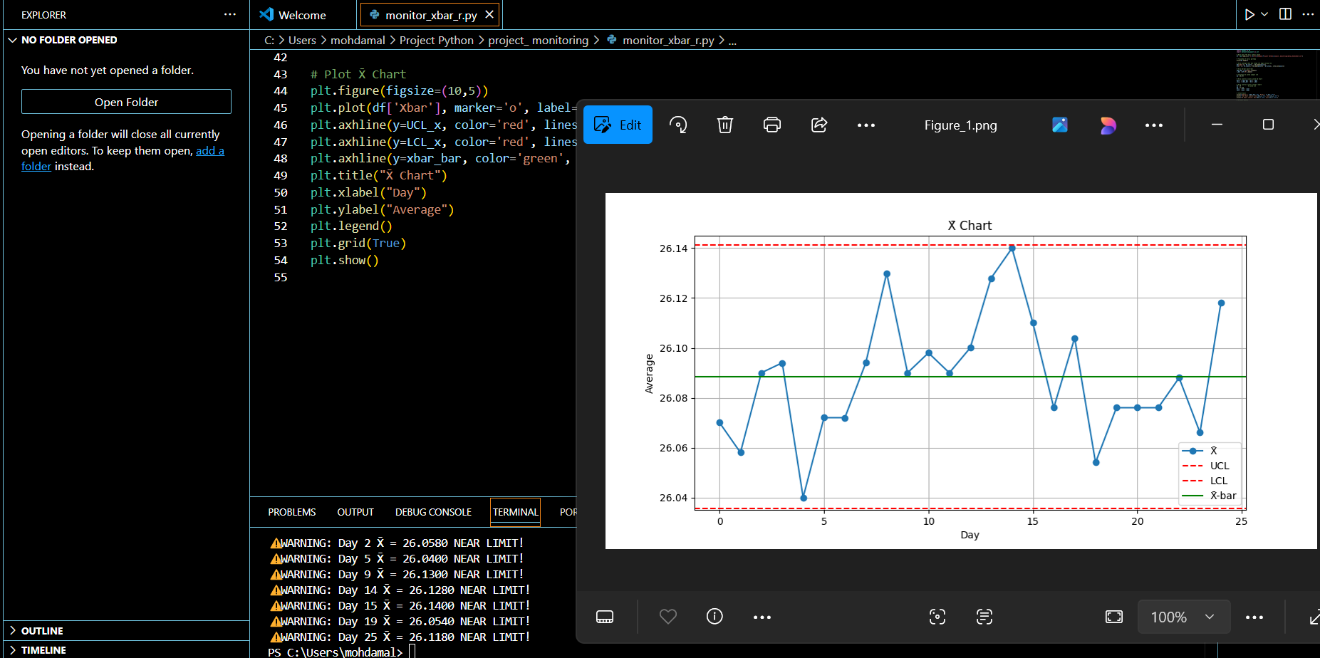
Untuk run script di terminal:-
python "C:\Users\mohdamal\Project Python\project_ monitoring\monitor_xbar_r.py"

Slide 2
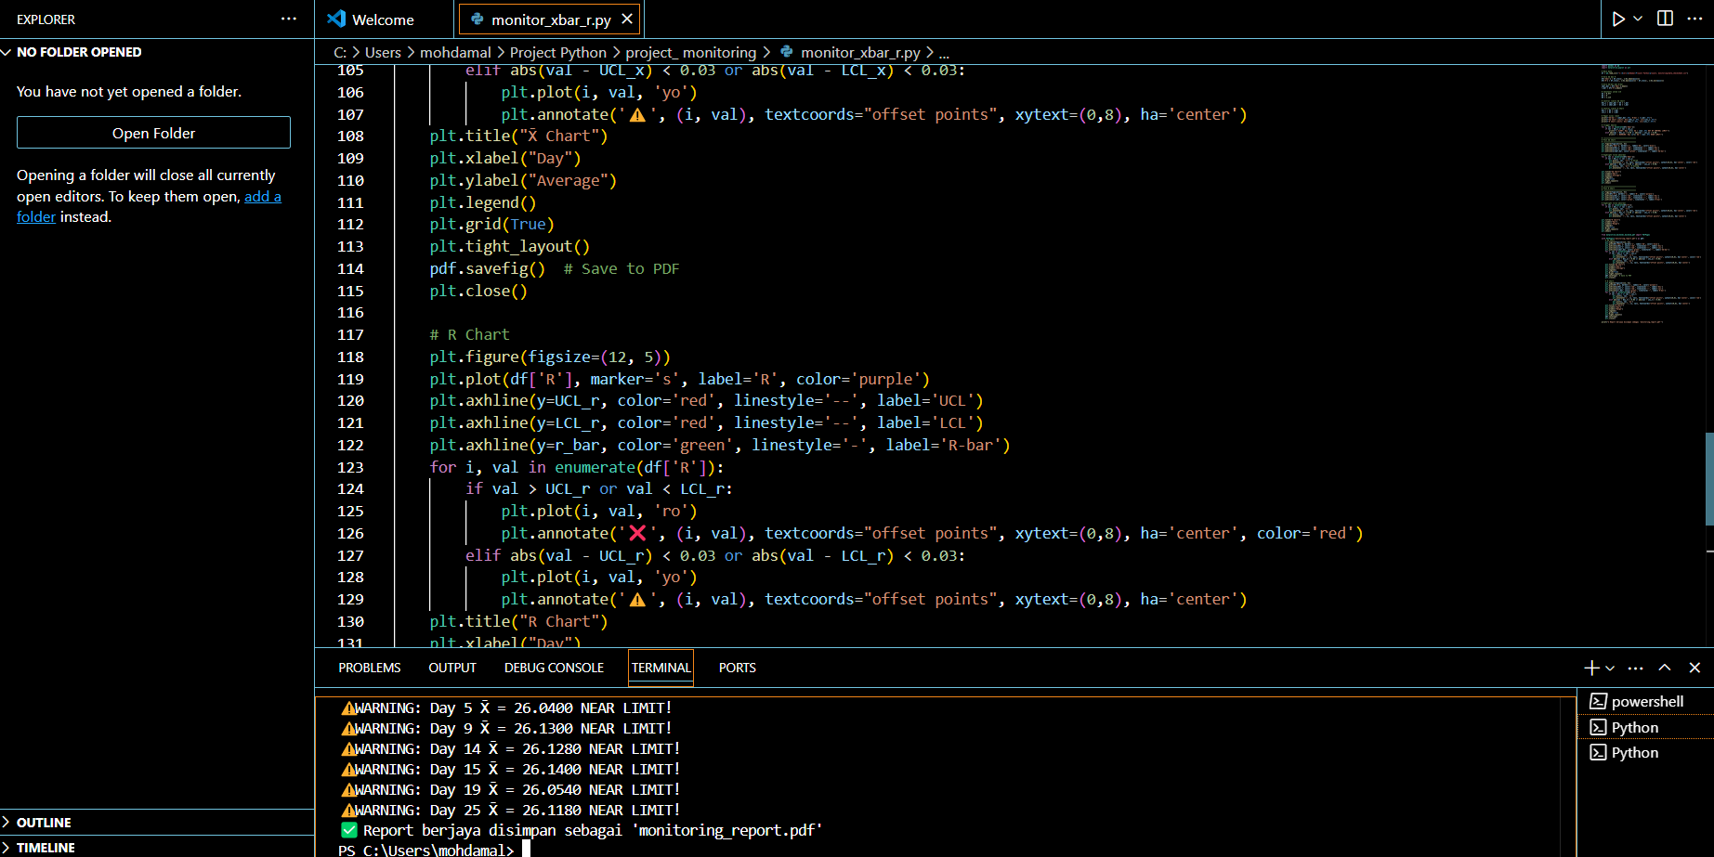
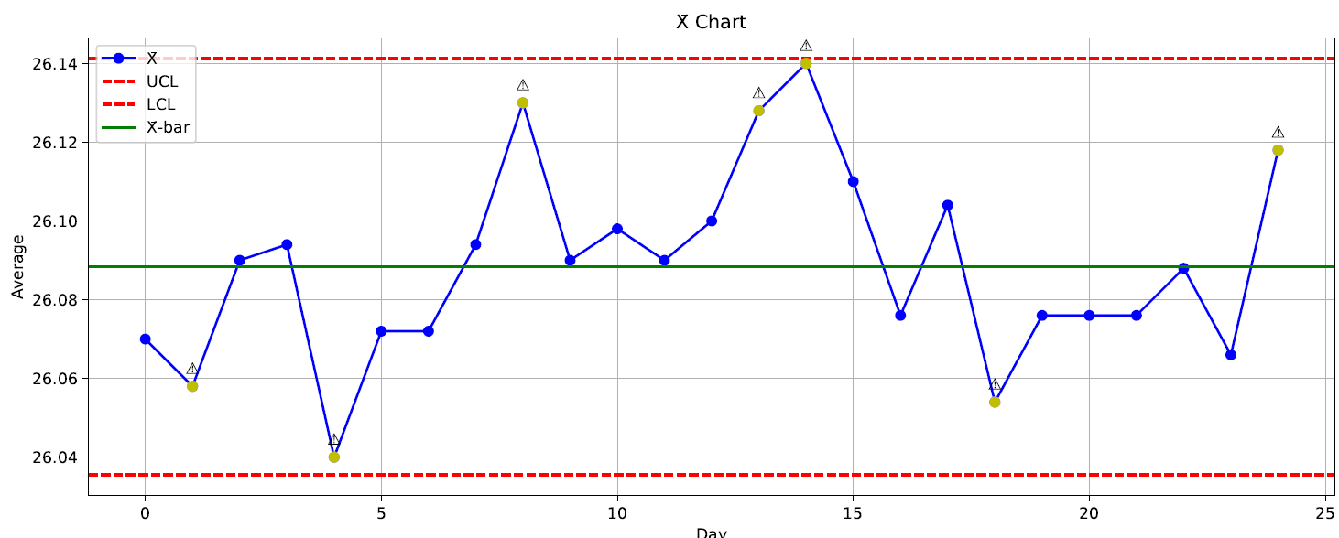
Untuk run script di terminal:-
python "C:\Users\mohdamal\Project Python\project_ monitoring\monitor_xbar_r.py"

Slide 3
import pandas as pd
import matplotlib.pyplot as plt
# Baca data
df = pd.read_csv(r"C:\Users\mohdamal\Project Python\project_ monitoring\data_checksheet.csv")
# Kira X̄ dan R
df['Xbar'] = df.iloc[:, 1:6].mean(axis=1)
df['R'] = df.iloc[:, 1:6].max(axis=1) - df.iloc[:, 1:6].min(axis=1)
# Kira X̄-bar dan R-bar
xbar_bar = df['Xbar'].mean()
r_bar = df['R'].mean()
# Constants untuk n=5
A2 = 0.577
D3 = 0
D4 = 2.114
# Control limits X̄ Chart
UCL_x = xbar_bar + A2 * r_bar
LCL_x = xbar_bar - A2 * r_bar
# Control limits R Chart
UCL_r = D4 * r_bar
LCL_r = D3 * r_bar
# Papar nilai limit
print(f"X̄-bar = {xbar_bar:.4f}, R-bar = {r_bar:.4f}")
print(f"X̄ Chart Limits: UCL={UCL_x:.4f}, LCL={LCL_x:.4f}")
print(f"R Chart Limits: UCL={UCL_r:.4f}, LCL={LCL_r:.4f}")
# Trigger Amaran
for i, val in enumerate(df['Xbar']):
if val > UCL_x or val < LCL_x:
print(f"❌ ALERT: Day {i+1} X̄ = {val:.4f} OUT OF CONTROL LIMIT!")
elif abs(val - UCL_x) < 0.03 or abs(val - LCL_x) < 0.03:
print(f"⚠️ WARNING: Day {i+1} X̄ = {val:.4f} NEAR LIMIT!")
# ===================================
# Plot X̄ Chart
# ===================================
plt.figure(figsize=(12, 5))
plt.plot(df['Xbar'], marker='o', label='X̄', color='blue')
plt.axhline(y=UCL_x, color='red', linestyle='--', label='UCL')
plt.axhline(y=LCL_x, color='red', linestyle='--', label='LCL')
plt.axhline(y=xbar_bar, color='green', linestyle='-', label='X̄-bar')
# Highlight titik abnormal
for i, val in enumerate(df['Xbar']):
if val > UCL_x or val < LCL_x:
plt.plot(i, val, 'ro') # merah
plt.annotate('❌', (i, val), textcoords="offset points", xytext=(0,8), ha='center', color='red')
elif abs(val - UCL_x) < 0.03 or abs(val - LCL_x) < 0.03:
plt.plot(i, val, 'yo') # kuning
plt.annotate('⚠️', (i, val), textcoords="offset points", xytext=(0,8), ha='center')
plt.title("X̄ Chart")
plt.xlabel("Day")
plt.ylabel("Average")
plt.legend()
plt.grid(True)
plt.tight_layout()
plt.show()
# ===================================
# Plot R Chart
# ===================================
plt.figure(figsize=(12, 5))
plt.plot(df['R'], marker='s', label='R', color='purple')
plt.axhline(y=UCL_r, color='red', linestyle='--', label='UCL')
plt.axhline(y=LCL_r, color='red', linestyle='--', label='LCL')
plt.axhline(y=r_bar, color='green', linestyle='-', label='R-bar')
# Highlight titik abnormal
for i, val in enumerate(df['R']):
if val > UCL_r or val < LCL_r:
plt.plot(i, val, 'ro')
plt.annotate('❌', (i, val), textcoords="offset points", xytext=(0,8), ha='center', color='red')
elif abs(val - UCL_r) < 0.03 or abs(val - LCL_r) < 0.03:
plt.plot(i, val, 'yo')
plt.annotate('⚠️', (i, val), textcoords="offset points", xytext=(0,8), ha='center')
plt.title("R Chart")
plt.xlabel("Day")
plt.ylabel("Range")
plt.legend()
plt.grid(True)
plt.tight_layout()
plt.show()
from matplotlib.backends.backend_pdf import PdfPages
with PdfPages('monitoring_report.pdf') as pdf:
# X̄ Chart
plt.figure(figsize=(12, 5))
plt.plot(df['Xbar'], marker='o', label='X̄', color='blue')
plt.axhline(y=UCL_x, color='red', linestyle='--', label='UCL')
plt.axhline(y=LCL_x, color='red', linestyle='--', label='LCL')
plt.axhline(y=xbar_bar, color='green', linestyle='-', label='X̄-bar')
for i, val in enumerate(df['Xbar']):
if val > UCL_x or val < LCL_x:
plt.plot(i, val, 'ro')
plt.annotate('❌', (i, val), textcoords="offset points", xytext=(0,8), ha='center', color='red')
elif abs(val - UCL_x) < 0.03 or abs(val - LCL_x) < 0.03:
plt.plot(i, val, 'yo')
plt.annotate('⚠️', (i, val), textcoords="offset points", xytext=(0,8), ha='center')
plt.title("X̄ Chart")
plt.xlabel("Day")
plt.ylabel("Average")
plt.legend()
plt.grid(True)
plt.tight_layout()
pdf.savefig() # Save to PDF
plt.close()
# R Chart
plt.figure(figsize=(12, 5))
plt.plot(df['R'], marker='s', label='R', color='purple')
plt.axhline(y=UCL_r, color='red', linestyle='--', label='UCL')
plt.axhline(y=LCL_r, color='red', linestyle='--', label='LCL')
plt.axhline(y=r_bar, color='green', linestyle='-', label='R-bar')
for i, val in enumerate(df['R']):
if val > UCL_r or val < LCL_r:
plt.plot(i, val, 'ro')
plt.annotate('❌', (i, val), textcoords="offset points", xytext=(0,8), ha='center', color='red')
elif abs(val - UCL_r) < 0.03 or abs(val - LCL_r) < 0.03:
plt.plot(i, val, 'yo')
plt.annotate('⚠️', (i, val), textcoords="offset points", xytext=(0,8), ha='center')
plt.title("R Chart")
plt.xlabel("Day")
plt.ylabel("Range")
plt.legend()
plt.grid(True)
plt.tight_layout()
pdf.savefig()
plt.close()
print("✅ Report berjaya disimpan sebagai 'monitoring_report.pdf'")
Script ni pun dah ok dah utk kluar graph x bar & r chart.
Copy untuk rujukan.

Slide 4
# Auto-naming PDF
today = datetime.now().strftime('%Y-%m-%d')
folder = r"C:\Users\mohdamal\Project Python\project_monitoring"
filename = f"monitoring_report_{today}.pdf"
output_path = os.path.join(folder, filename)

Slide 6
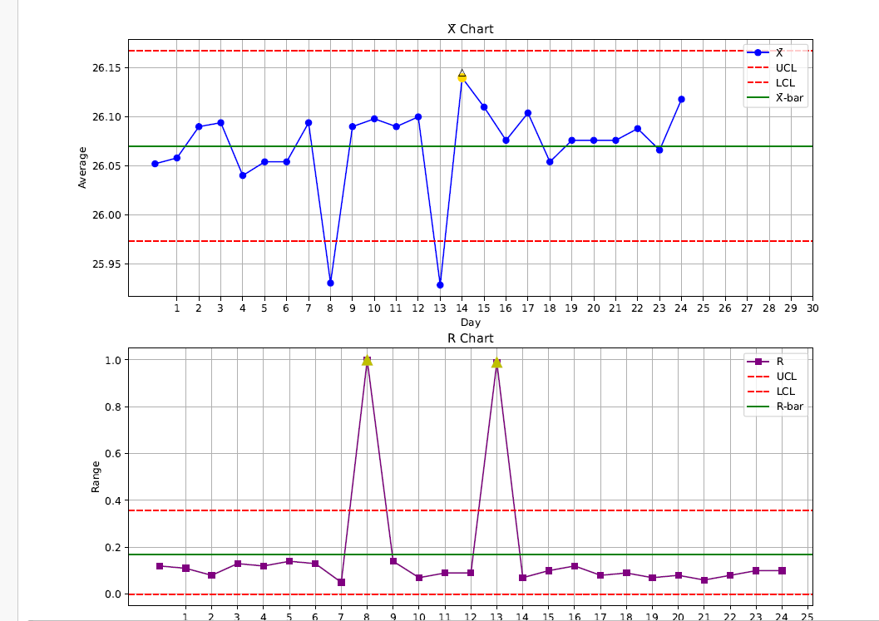
Scriptnya di slide bawah.
monitor_xbar_r.py
Copy untuk rujukan. Ni paling ok.
Data ni,dia guna data yg dalam file (data_checksheet).
Run di terminal:
python C:\Users\mohdamal\Project Python\project_monitoring\monitor_xbar_r.py"

Slide 7
import pandas as pd
import numpy as np
import matplotlib.pyplot as plt
from datetime import datetime
# === BACA DATA DARI FAIL (ganti ini dengan path fail Excel/CSV anda) ===
# df = pd.read_excel('data.xlsx') # jika dari Excel
# Untuk demo: generate 31 hari data rawak sekitar 26.0 - 26.2
np.random.seed(42)
data = np.random.normal(loc=26.08, scale=0.05, size=(31, 5)) # 31 hari x 5 sample
df = pd.DataFrame(data, columns=['P1', 'P2', 'P3', 'P4', 'P5'])
# === KIRA X̄ DAN R ===
df['X̄'] = df.mean(axis=1)
df['R'] = df.max(axis=1) - df.min(axis=1)
# === X̄-R CONTROL LIMITS ===
x_bar = df['X̄'].mean()
r_bar = df['R'].mean()
n = 5
A2 = 0.577
D3 = 0
D4 = 2.114
UCL_x = x_bar + A2 * r_bar
LCL_x = x_bar - A2 * r_bar
UCL_r = D4 * r_bar
LCL_r = D3 * r_bar
# === ALERT ZONE ===
x_alert_high = x_bar + 0.9 * (UCL_x - x_bar)
x_alert_low = x_bar - 0.9 * (x_bar - LCL_x)
r_alert_high = r_bar + 0.9 * (UCL_r - r_bar)
# === PLOT X̄-R CHART ===
fig, axs = plt.subplots(2, 1, figsize=(14, 8), sharex=True)
# X̄ Chart
axs[0].plot(df['X̄'], marker='o', color='blue', label='X̄')
axs[0].axhline(UCL_x, color='red', linestyle='--', label='UCL')
axs[0].axhline(LCL_x, color='red', linestyle='--', label='LCL')
axs[0].axhline(x_bar, color='green', linestyle='-', label='X̄-bar')
for i, val in enumerate(df['X̄']):
if val > x_alert_high or val < x_alert_low:
axs[0].plot(i, val, marker='^', color='gold', markersize=10)
axs[0].set_title("X̄ Chart")
axs[0].set_ylabel("Average")
axs[0].grid(True)
axs[0].legend()
# R Chart
axs[1].plot(df['R'], marker='s', color='purple', label='R')
axs[1].axhline(UCL_r, color='red', linestyle='--', label='UCL')
axs[1].axhline(LCL_r, color='red', linestyle='--', label='LCL')
axs[1].axhline(r_bar, color='green', linestyle='-', label='R-bar')
for i, val in enumerate(df['R']):
if val > r_alert_high:
axs[1].plot(i, val, marker='^', color='gold', markersize=10)
axs[1].set_title("R Chart")
axs[1].set_xlabel("Day")
axs[1].set_ylabel("Range")
axs[1].grid(True)
axs[1].legend()
# Set X axis ticks 1-31
axs[1].set_xticks(range(31))
axs[1].set_xticklabels(range(1, 32))
plt.tight_layout()
# === AUTO SAVE ===
timestamp = datetime.now().strftime('%Y%m%d_%H%M%S')
filename = f'xbar_r_chart_{timestamp}.png'
plt.savefig (filename)
print(f"[✔] X̄-R Chart saved as {filename}")
plt.show()
# === PLOT CPK ===
USL = 26.2
LSL = 25.9
mu = df['X̄'].mean()
sigma = df['X̄'].std(ddof=1)
cpk = min((USL - mu) / (3 * sigma), (mu - LSL) / (3 * sigma))
plt.figure(figsize=(10, 5))
plt.hist(df['X̄'], bins=10, color='skyblue', edgecolor='black', density=True)
plt.axvline(mu, color='green', linestyle='--', label=f'Mean = {mu:.3f}')
plt.axvline(USL, color='red', linestyle='--', label='USL')
plt.axvline(LSL, color='red', linestyle='--', label='LSL')
plt.title(f'CPK Chart\nCPK = {cpk:.3f}')
plt.xlabel('Measurement')
plt.ylabel('Density')
plt.grid(True)
plt.legend()
# Auto save CPK chart
cpk_filename = f'cpk_chart_{timestamp}.png'
plt.savefig(cpk_filename)
print(f"[✔] CPK Chart saved as {cpk_filename}")
plt.show()
Scriptnya
monitor_xbar_r.py
Copy untuk rujukan. Ni paling ok.

Slide 8
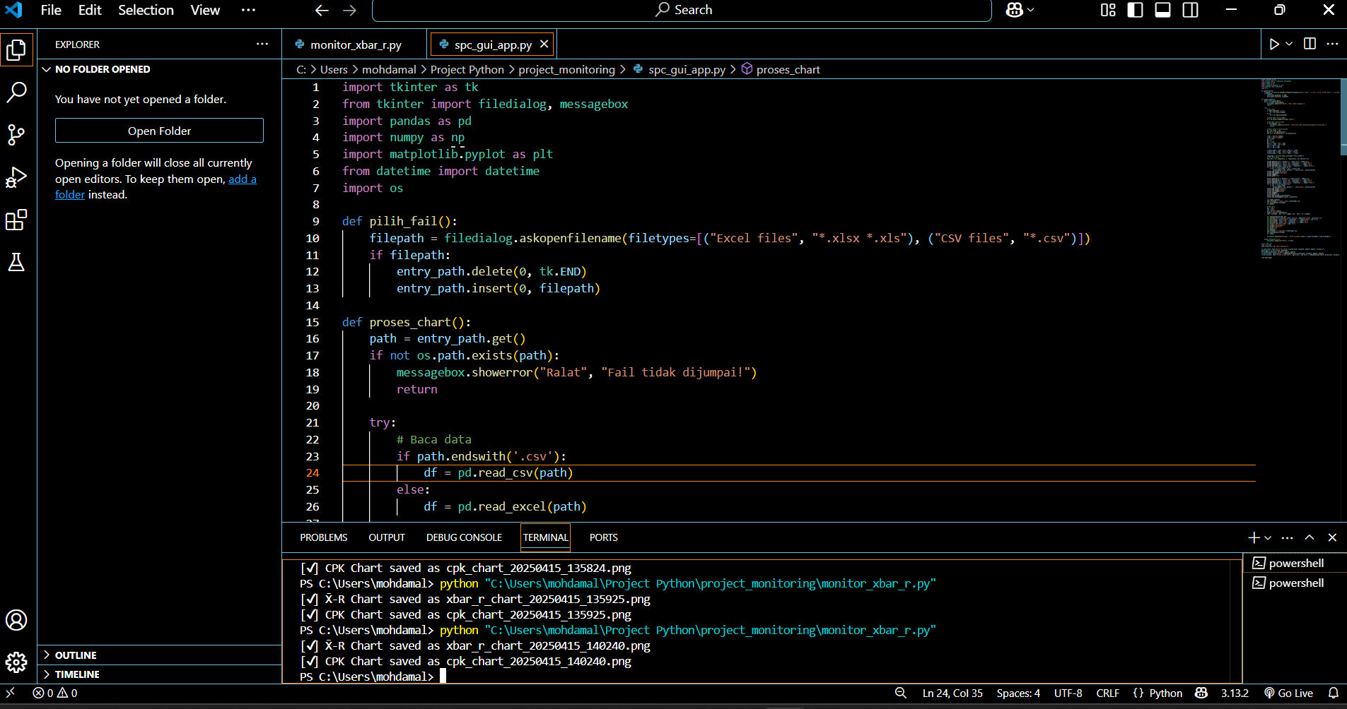
Scriptnya di slide bawah. (spc_gui_app.py)
Run di terminal:
python "C:\Users\mohdamal\Project Python\project_monitoring\monitor_xbar_r.py"

Slide 9
import tkinter as tk
from tkinter import filedialog, messagebox
import pandas as pd
import numpy as np
import matplotlib.pyplot as plt
from datetime import datetime
import os
def pilih_fail():
filepath = filedialog.askopenfilename(filetypes=[("Excel files", "*.xlsx *.xls"), ("CSV files", "*.csv")])
if filepath:
entry_path.delete(0, tk.END)
entry_path.insert(0, filepath)
def proses_chart():
path = entry_path.get()
if not os.path.exists(path):
messagebox.showerror("Ralat", "Fail tidak dijumpai!")
return
try:
# Baca data
if path.endswith('.csv'):
df = pd.read_csv(path)
else:
df = pd.read_excel(path)
# Hanya ambil kolum nombor
df = df.select_dtypes(include='number')
# Pastikan cukup 5 kolum
if df.shape[1] < 5:
messagebox.showerror("Ralat", "Fail perlu ada sekurang-kurangnya 5 kolum data.")
return
# Ambil hanya 5 kolum pertama
df = df.iloc[:, :5]
df['X̄'] = df.mean(axis=1)
df['R'] = df.max(axis=1) - df.min(axis=1)
x_bar = df['X̄'].mean()
r_bar = df['R'].mean()
A2 = 0.577
D3 = 0
D4 = 2.114
UCL_x = x_bar + A2 * r_bar
LCL_x = x_bar - A2 * r_bar
UCL_r = D4 * r_bar
LCL_r = D3 * r_bar
x_alert_high = x_bar + 0.9 * (UCL_x - x_bar)
x_alert_low = x_bar - 0.9 * (x_bar - LCL_x)
r_alert_high = r_bar + 0.9 * (UCL_r - r_bar)
timestamp = datetime.now().strftime('%Y%m%d_%H%M%S')
# Plot X̄-R Chart
fig, axs = plt.subplots(2, 1, figsize=(12, 8), sharex=True)
axs[0].plot(df['X̄'], marker='o', color='blue', label='X̄')
axs[0].axhline(UCL_x, color='red', linestyle='--', label='UCL')
axs[0].axhline(LCL_x, color='red', linestyle='--', label='LCL')
axs[0].axhline(x_bar, color='green', linestyle='-', label='X̄-bar')
for i, val in enumerate(df['X̄']):
if val > x_alert_high or val < x_alert_low:
axs[0].plot(i, val, marker='^', color='gold', markersize=10)
axs[0].set_title("X̄ Chart")
axs[0].set_ylabel("Average")
axs[0].legend()
axs[0].grid(True)
axs[1].plot(df['R'], marker='s', color='purple', label='R')
axs[1].axhline(UCL_r, color='red', linestyle='--', label='UCL')
axs[1].axhline(LCL_r, color='red', linestyle='--', label='LCL')
axs[1].axhline(r_bar, color='green', linestyle='-', label='R-bar')
for i, val in enumerate(df['R']):
if val > r_alert_high:
axs[1].plot(i, val, marker='^', color='gold', markersize=10)
axs[1].set_title("R Chart")
axs[1].set_ylabel("Range")
axs[1].set_xlabel("Day")
axs[1].legend()
axs[1].grid(True)
axs[1].set_xticks(range(len(df)))
axs[1].set_xticklabels(range(1, len(df)+1))
plt.tight_layout()
xbar_filename = f'xbar_r_chart_{timestamp}.png'
plt.savefig(xbar_filename)
plt.show()
# CPK chart
USL = 26.2
LSL = 25.9
mu = df['X̄'].mean()
sigma = df['X̄'].std(ddof=1)
cpk = min((USL - mu) / (3 * sigma), (mu - LSL) / (3 * sigma))
plt.figure(figsize=(10, 5))
plt.hist(df['X̄'], bins=10, color='skyblue', edgecolor='black', density=True)
plt.axvline(mu, color='green', linestyle='--', label=f'Mean = {mu:.3f}')
plt.axvline(USL, color='red', linestyle='--', label='USL')
plt.axvline(LSL, color='red', linestyle='--', label='LSL')
plt.title(f'CPK Chart\nCPK = {cpk:.3f}')
plt.xlabel('Measurement')
plt.ylabel('Density')
plt.grid(True)
plt.legend()
cpk_filename = f'cpk_chart_{timestamp}.png'
plt.savefig(cpk_filename)
plt.show()
messagebox.showinfo("Berjaya", f"Graf disimpan sebagai:\n{xbar_filename}\n{cpk_filename}")
except Exception as e:
messagebox.showerror("Ralat", str(e))
# ==== GUI ====
root = tk.Tk()
root.title("Mini SPC Chart Generator")
tk.Label(root, text="Pilih Fail Data:").grid(row=0, column=0, padx=5, pady=5, sticky="e")
entry_path = tk.Entry(root, width=50)
entry_path.grid(row=0, column=1, padx=5, pady=5)
tk.Button(root, text="Browse", command=pilih_fail).grid(row=0, column=2, padx=5, pady=5)
tk.Button(root, text="Proses & Jana Chart", bg="green", fg="white", command=proses_chart).grid(row=1, column=1, pady=10)
root.mainloop()
Scriptnya (spc_gui_app.py)

Slide 10
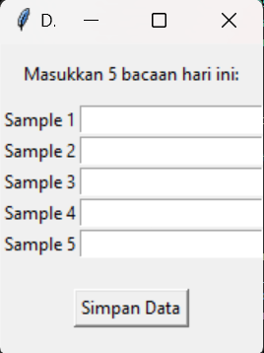
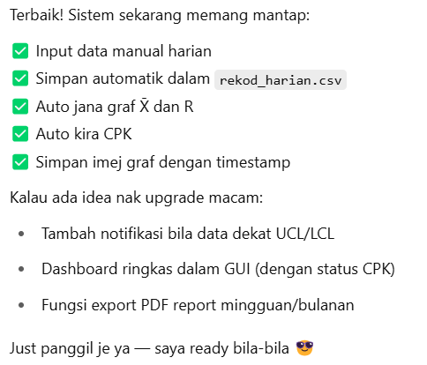
Latest run diterminal : 18.4.2025 (daily_checklist_app.py)
python "C:\Users\mohdamal\Project Python\project_monitoring\daily_checklist_app.py"
1. Stakat 17,18 & 19 .04.2025 data x-length yg direkodkan masuk dalam file rekod_harian.
Status: 18.4.2025
Data mention dlm terminal bila dh run script

Slide 11
Masalah yang perlu diselesaikan: 18.4.2025
Di file python: generate_xbar_r_cpk.py error utk run supaya dpt baca data di file rekod harian (dlm folder Daily Result) = Dah selesai, rujuk slide dibawah. Done(19.04.2025)
Masalah ni perlu diselesaikan bila keseluruhan file python daily_checklist_app.py berfungsi dgn baik. = Minta monitor perkara ni, sehingga dapat collect data selama sebulan.

Slide 12
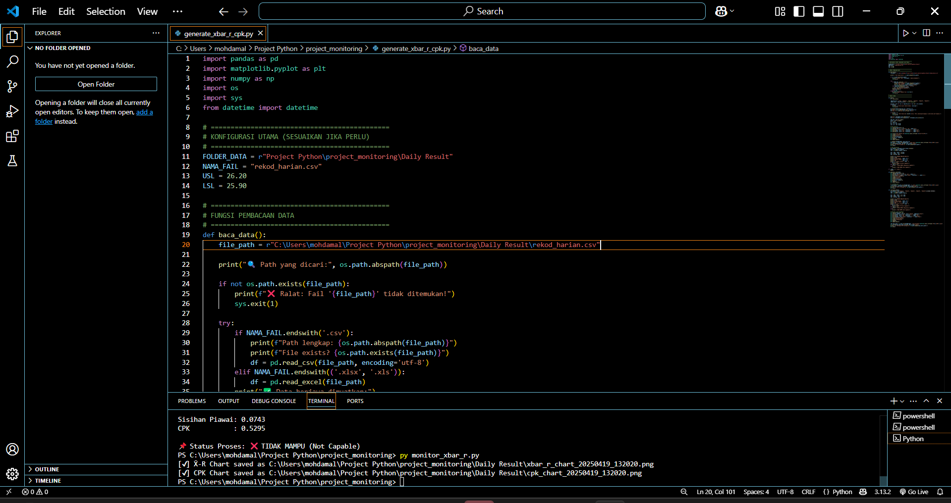
19.04.2025 - Sabtu
Nota Khas untuk file generate_xbar_r.py
Ni code perlu run diterminal jika tak boleh run: akan keluar error.
cd "C:\Users\mohdamal\Project Python\project_monitoring"
>> python generate_xbar_r_cpk.py
A - (nanti main path di terminal akan jadi,
PS C:\Users\mohdamal\Project Python\project_monitoring> )
B – (lepas tu baru boleh guna: python generate_xbar_r_cpk.py)
✅ Next step cadangan:
Nak aku bantu kemaskan:
Struktur folder simpan graf?
Tambah fungsi notifikasi kalau X̄ dekat UCL/LCL?
Tambah fungsi auto open graf selepas generate?
Masukkan fungsi generate_r_chart() dan calculate_cpk() ke dalam main() supaya fully integrated?
Atau nak tambah lagi rekod harian dan tengok perubahan CPK dalam masa sebenar?
Next:
Monitor dalam 30 hari..kita tgk apa result

Slide 13
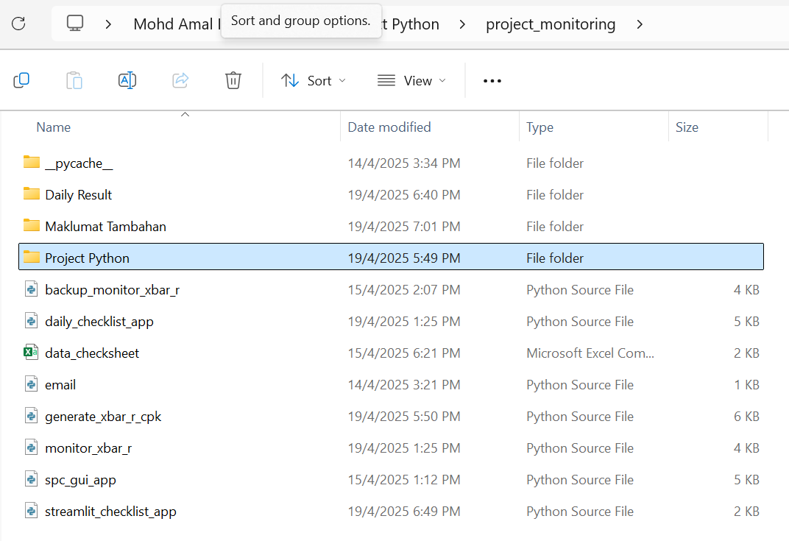
19.04.2025 - Sabtu
Bila run generate_xbar_r_cpk.py : graf akan simpan di folder baru..
Perfect! 💯 Good call.
Monitor dulu data real selama 30 hari—nanti kita boleh:
✅ Lihat trend sebenar proses ✅ Kenal pasti bila mula "lari" dari sasaran ✅ Buat keputusan tepat untuk tambah automation atau alert
Bila dah cukup data nanti, kita boleh:
🔧 Tambah fungsi amaran bila trend X̄ makin dekat dengan UCL/LCL 📊 Bina dashboard mini dalam GUI 📤 Auto-export PDF mingguan/bulanan untuk report 📌 Integrasi email atau notifikasi kalau perlu
Apa-apa jadi sepanjang tempoh monitoring tu, bila-bila je boleh panggil CGPT—on standby 😎

Slide 14
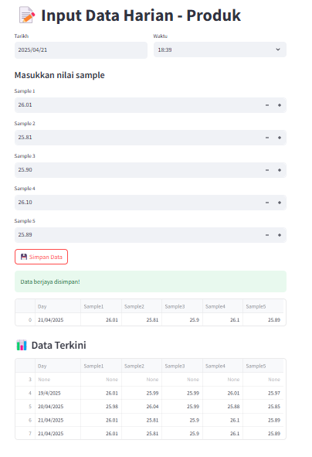
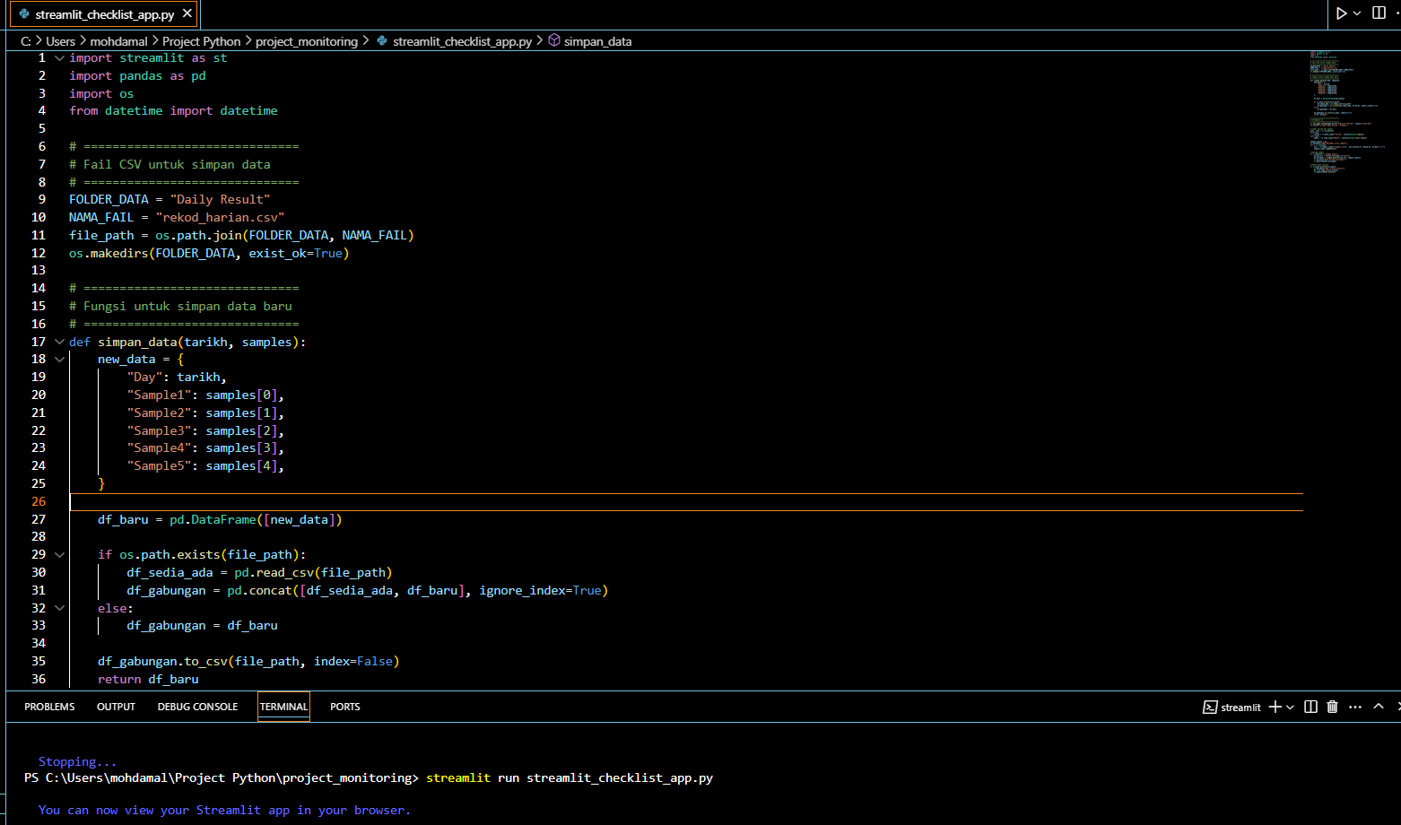
Streamlit_checklist_app.py
Proposal untuk bina app,supaya operator boleh fill in data on the spot at line.
Path yg perlu ada untuk run diterminal:
C:\Users\mohdamal\Project Python\project_monitoring> streamlit run streamlit_checklist_app.py
Nota: mcm biase,sekiranya..baru open file..path tak sama bila nak run diterminal..
cd "C:\Users\mohdamal\Project Python\project_monitoring"

Slide 15

20.04.2025 - Ahad
Trial utk bina app secara open source
Cube untuk guna GitHub & Streamlit app,tetapi result NG..
Details password GitHub & Streamlit ada dalam buku sbg catatan.
Status : FAILED

Slide 16
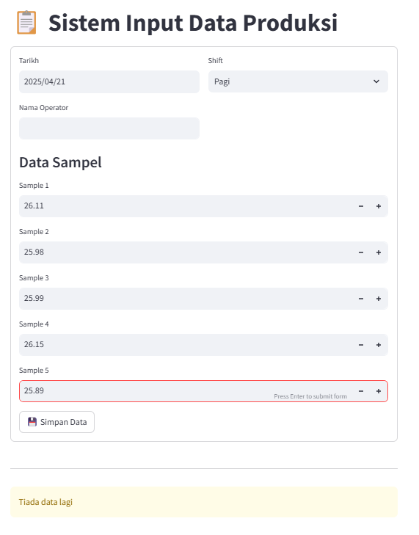
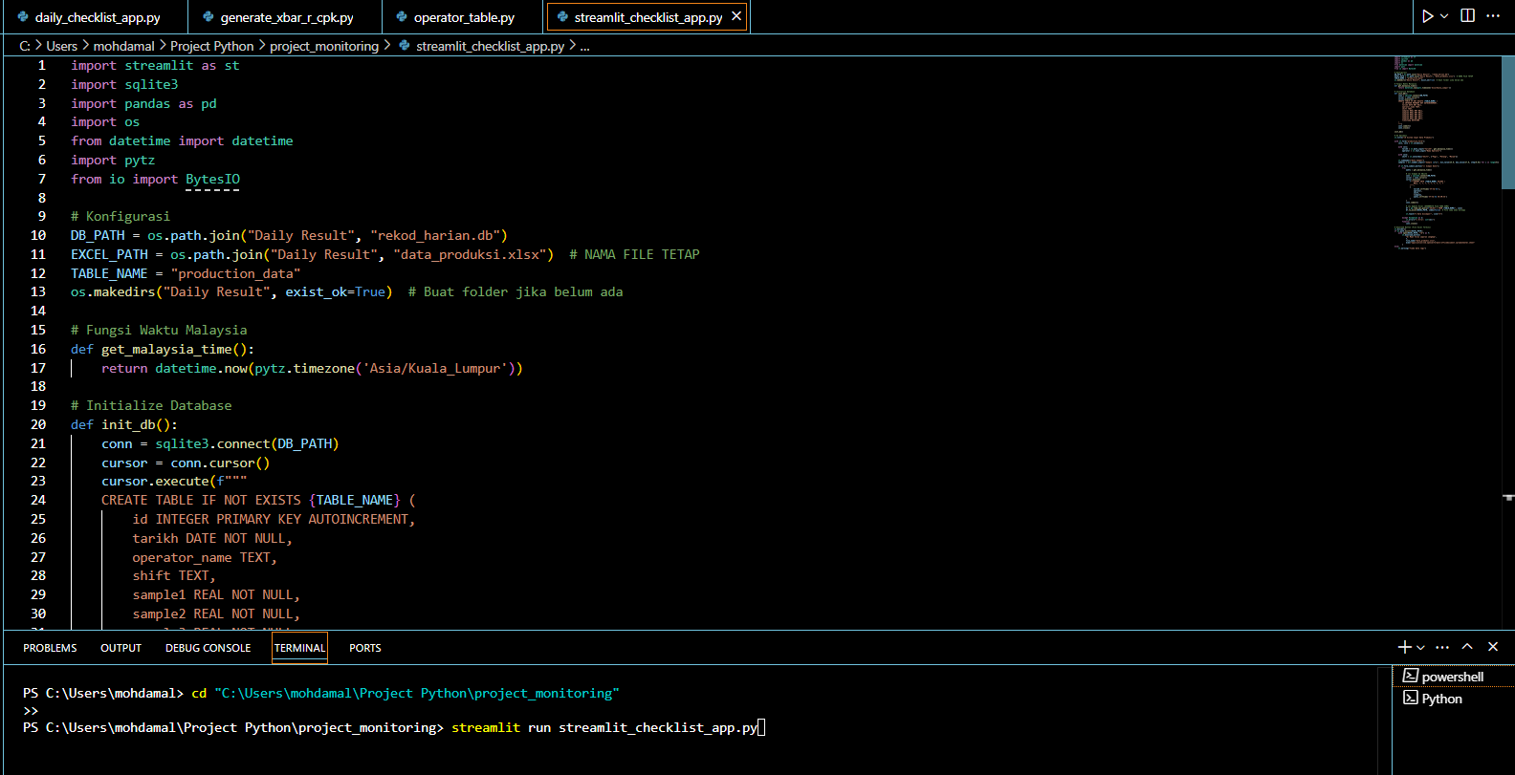
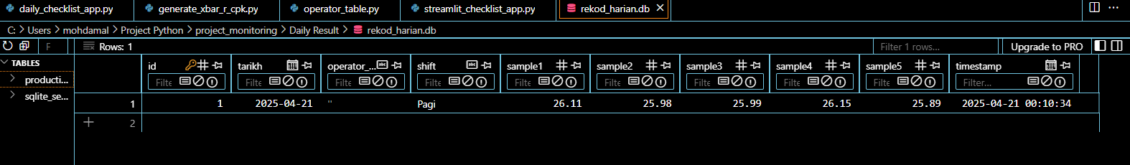
20.04.2025 - Ahad
Local URL: http://localhost:8501
Network URL: http://192.168.148.144:8501
Improve file streamlit_checklist_app.py
Run di terminal:
streamlit run streamlit_checklist_app.py
File: rekod_harian.db
Status: In-progress dlm link to operator

Slide 17
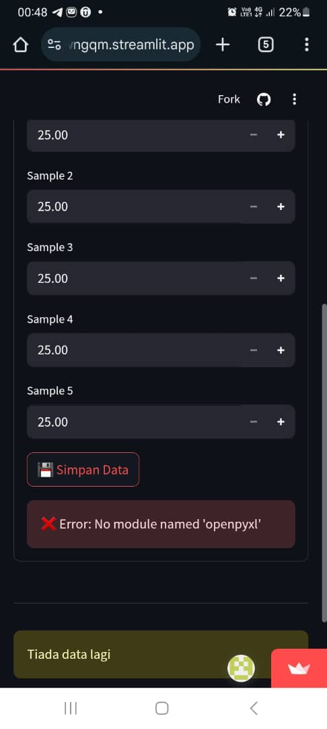
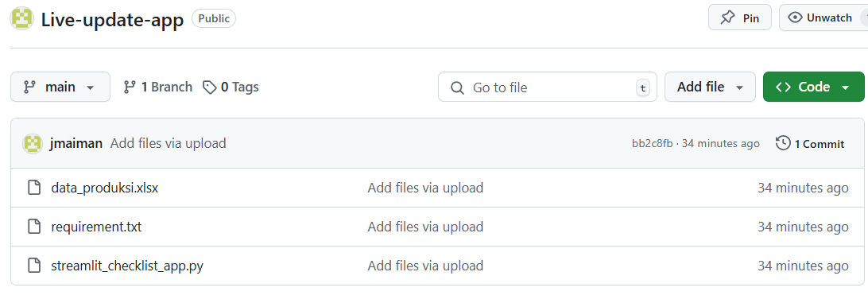
Ni folder yg ada dalam GitHub
Keluar error tu.
https://live-update-app-jqnzoapkhsaqg8aprwngqm.streamlit.app/
(ni dah ada,tp bila nak save data..tak boleh) keluar ❌ Error: No module named 'openpyxl'
Status : SUCCES by 21.04.2025
(Please refer to the next slide)

Slide 18
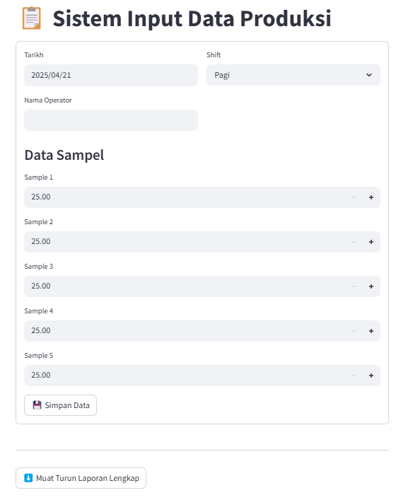

Kaedah menggunakan system – Paperless (Guna URL)
Aturcara Kerja
PIC : klik URL by using HP/PC/Laptop.
Interface format comes out in the streamlit application.
Manually update real data as per production status.
Klik Simpan Data.
Klik Muat Turun Laporan Lengkap utk excel file.
Status : SUCCES by 21.04.2025
Tetapi: Data record disimpan tak lama,perlu sentiasa muat turun file excel selepas operator update data..
Klik:
https://live-update-app-jqnzoapkhsaqg8aprwngqm.streamlit.app/

Slide 19
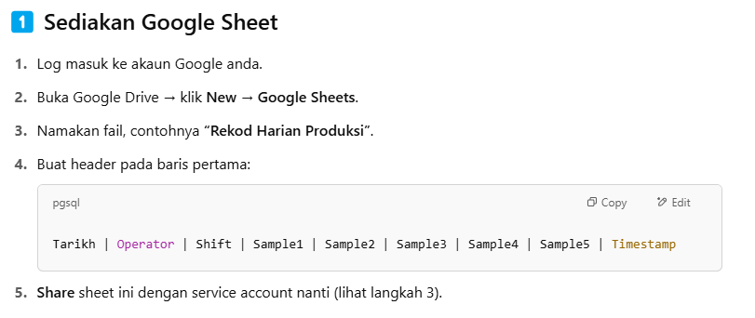
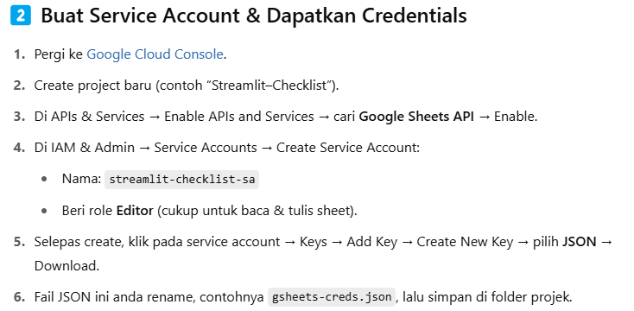
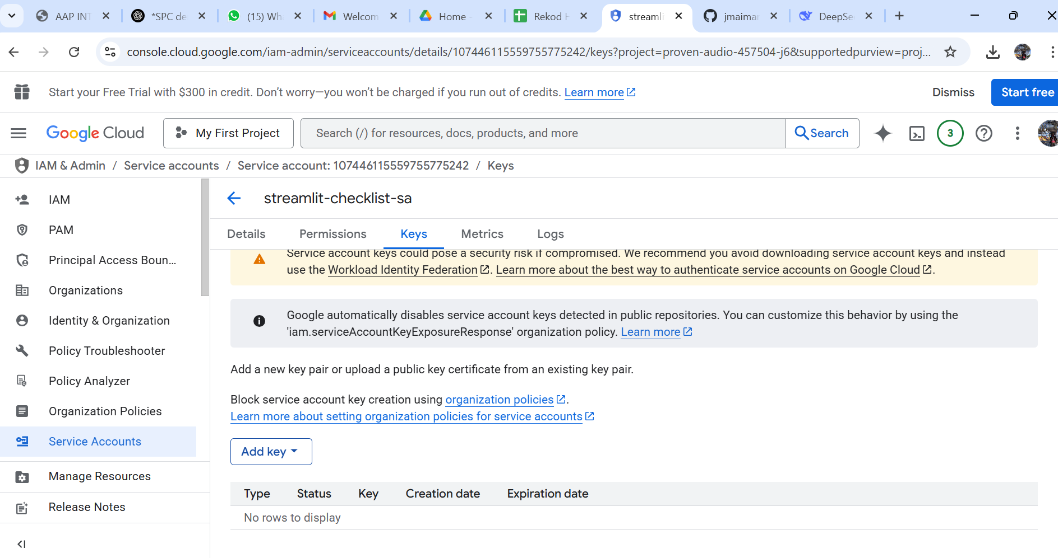
Kaedah menggunakan system – Paperless (Google Sheet)
https://console.cloud.google.com/
https://console.cloud.google.com/iam-admin/serviceaccounts/details/107446115559755775242/keys?project=proven-audio-457504-j6&supportedpurview=project

Slide 20
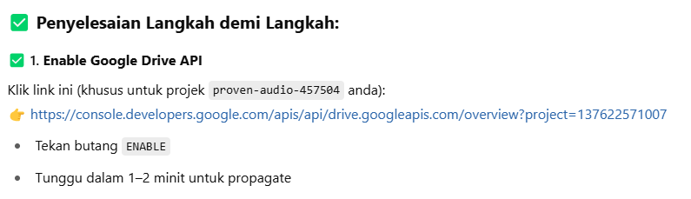
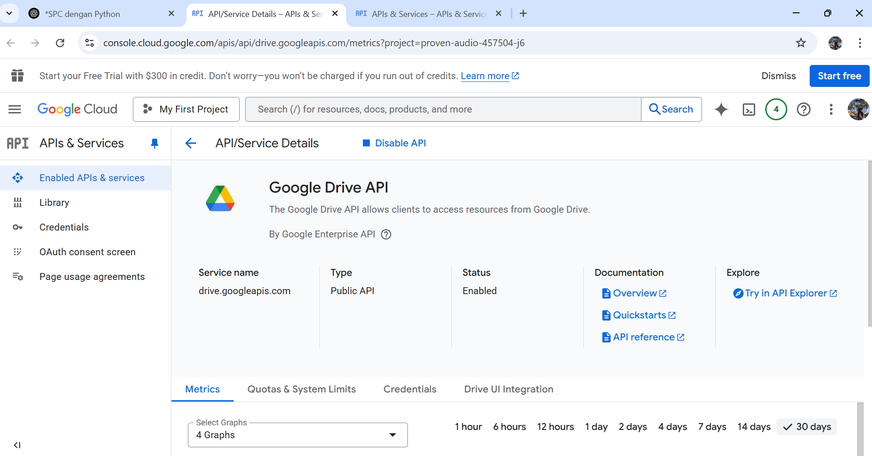
Sebagai rujukan;
https://console.developers.google.com/apis/api/drive.googleapis.com/overview?project=137622571007

Slide 21
from google.oauth2.service_account import Credentials
# Guna credentials dari Streamlit Secrets
creds_dict = json.loads(st.secrets["GSHEETS_CREDENTIALS"])
creds = Credentials.from_service_account_info(creds_dict)

